Slide 1

MAJOR PROJECT (BCAN-691)
PPT presentation
on
Hotel management system
SESSION: 2019-2022
SUBMITTED BY: (BCA 6th Sem)
SIDDHARTHA KHAWAS (32201219075)
SHIVENDU SHIVAM (32201219074)
SUBHAM CHAKRABORTY (32201219061)
DIPAK KUMAR YADAV (32201219055)
RAHUL KUMAR (32201219012)
ASANSOL ENGINEERING COLLEGE (AEC)
Asansol, West Bengal
UNDER THE GUIDANCE OF:
Mr. Tapan Kumar Das
Assistant Professor
Department of Computer Application

Slide 2
ACKNOWLEDGEMENT
We would like to express our special thanks and gratitude to our guide Mr. Tapan Kumar Das, Asst. Professor Department of Computer Application. We would like to thanks our HOD sir Dr. Dibyendu Kumar Pal to provide us the opportunity to carry out the project. We would also like to thanks our honorable principal sir Dr. P.P Bhattacharya who gave us the golden opportunity to do this wonderful project entitled “HOTEL MANAGEMENT SYSTEM”, which also helped us in doing lots of research and we came to know about so many new things. We are really thankful to them.
We would also like to thank other faculty members of our Department, our parents and group members to complete the project within time.
Thank You all for your support.
SIDDHARTHA KHAWAS (32201219075)
SHIVENDU SHIVAM (32201219074)
SUBHAM CHAKRABORTY (32201219061)
DIPAK KUMAR YADAV (32201219055)
RAHUL KUMAR (32201219012)

Slide 3
DECLARATION
We hereby declare that the project entitled- “HOTEL MANAGEMENT SYSTEM”, which is being submitted as Major Project of 6th semester in Bachelor of Computer Applications (BCA) to Asansol Engineering College, Asansol (W.B) is the record of our genuine work under the guidance of our guide Mr. Tapan Kumar Das Asst. Professor Department of Computer Application Asansol Engineering College, Asansol
SIDDHARTHA KHAWAS (32201219075)
SHIVENDU SHIVAM (32201219074)
SUBHAM CHAKRABORTY (32201219061)
DIPAK KUMAR YADAV (32201219055)
RAHUL KUMAR (32201219012)
Place:
Date:

Slide 4
Table of Content
Synopsis
Introduction of the project
Objective of the Project
Hardware and software requirements
Purpose of the Project
Features of This Project
Entity Relationship Diagrams(ERD)
Dataflow Diagrams(DFD)
5. Login to Hotel management system
6. Functions in the system
Customer.
Room.
Details.
Logout.
7. Output Screen
8. Advantages of the proposed system
9. Disadvantages of the System
10. Future scope
11. Bibliography & References

Slide 5
INTRODUCTION
A hotel is a hive of numerous operations such as front office, booking, and reservation, banquet, finance, HR, inventory, material management, quality management, security, energy management, housekeeping, CRM and more. The hotel has some rooms, and these rooms are of different categories. By room category, each room hast the different price. A hotel has employees to manage the services provided to customers. It is quite important to store the customer record in hotel database which contains customer identity, his address, check in time, check out time, etc., for future and security purposes. Hotel provides food and beverages to their customers and generates the bill for this at the time of their check out.
Currently, there are many hotels which lack a common platform for all these functionalities to work together. Databases will be required in huge amount to store all this information and to be retrieved as and when required. Handling of such a huge database will also require a reliable and efficient software for application.

Slide 6
Objective of the Project
Currently, there are many hotels which lack a common platform for all these functionalities to work together. Databases will be required in huge amount to store all this information and to be retrieved as and when required. Handling of such a huge database will also require a reliable and efficient software for application. It is capable of hosting almost all the features that can be required by a hotel.

Slide 7
Hardware &Software Requirement
The minimum hardware and software configuration for application to run is as follows.
HARDWARE:-
Microprocessor: - Intel® Core™ i3 processors (Or equivalent)
Ram:- 4 GB
Hard Drive: - 500 GB
SOFTWARE:-
Operating System: - WINDOWS 10/11
Languages: - Python, MySQL

Slide 8
Purpose Of the Project
The system aims at the maintenance and management of the different Hotels. It mainly takes care of the Hotel management at the core area of the database.
In the front end we using Python and in the backend we using mysql under the Microsoft windows operating system.

Slide 9
Features of the project
It saves user time in searching a room.
The system is useful as it calculates an exact cost of rooms for requested number of days.
It saves organization resources and expenses.
This system is effective and saves time and cost of users.

Slide 10
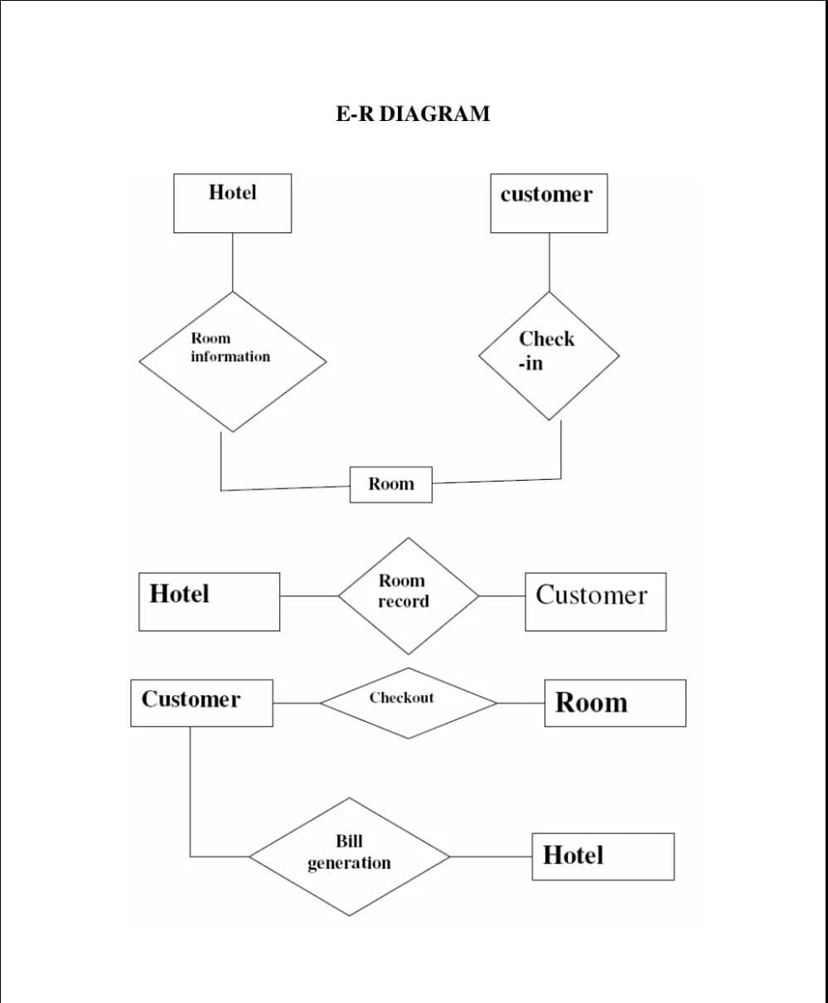
ER Diagrams

Slide 11
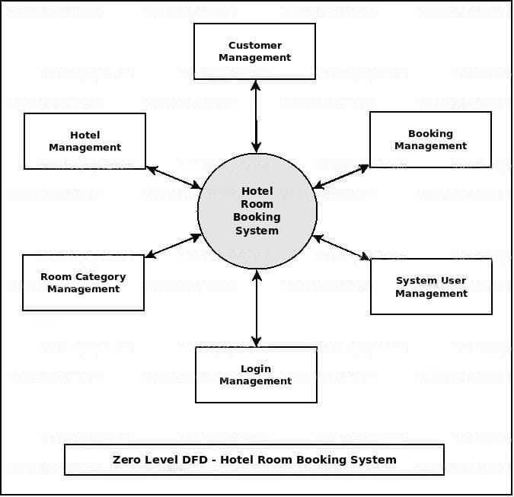
Dataflow diagrams

Slide 12
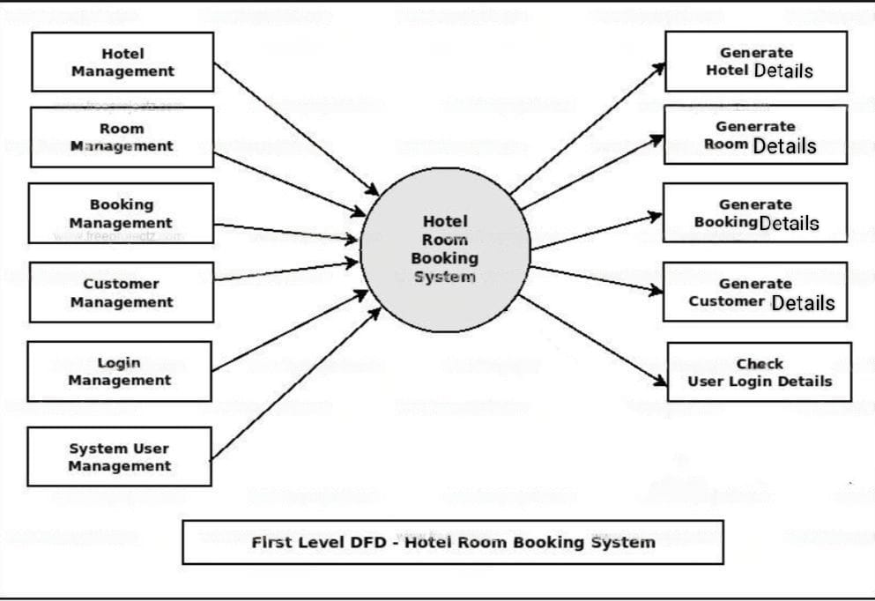

Slide 13
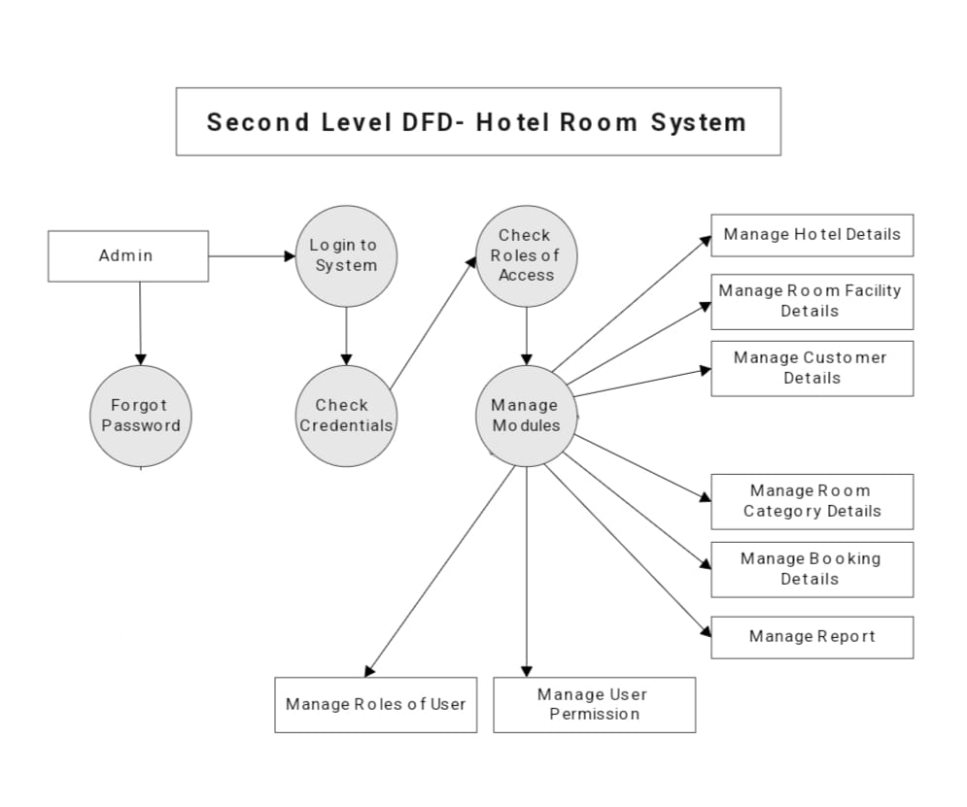

Slide 14
LOGIN TO Hotel management system
This part of paper includes security for hotel management system which contains username &password implemented. This design includes User name and Password, New User Register also forget password. If the user entered the wrong password or the wrong user id, a message appears that the password and user id is wrong. We have created the login page using python and MySQL and then link the python with MySQL database, so if someone enters the right user's name and password then it will redirect to the hotel management system.User also create a new user id and password . We also provided another option the name is forget password. When the user can't remember his password then click this button. This option provided the user how to create a new password.

Slide 15
Add customer Function
When we want to insert the customers details in the database then we use the customer option. This option provided many features like (Customer Ref No, customer Name, Customer Father Name, Customer Gender, Postal code, Customer mobile number, Customer email, Customer nationality, Customer ID Proof Type, ID Number and Customer Address) this all functions are help full for user to insert the data.
Duplicate entries are not allowed here.
We have four buttons in customer window. The buttons are ADD, UPDATE,DELETE and RESET. below we discuss the features of four button.

Slide 16
Add Room details function
This window provides lots of features for the user like at first the user fetch data by using customer contact number. Then he put the customer's name, check in and out dates, room types (Single, Duplex, Luxury), Available rooms, types of meal (Breakfast, Lunch, Dinner, All Combo),No. Of Days he lived, paid tax, subtotal, total cost is generated automatically by the pressing GENBILL button. Add, update, delete, reset buttons are used by like previous.
We also added one button is print button where the user can print the bill for the customer.

Slide 17
Add Room booking details function
Here the user can create floor, room no, types of room like single, duplex, luxury.
Also, we can change the status of room is available or booked. Add, update , reset buttons are also use here.

Slide 18
Logout button
This button is used to exit from the proposed system.

Slide 19
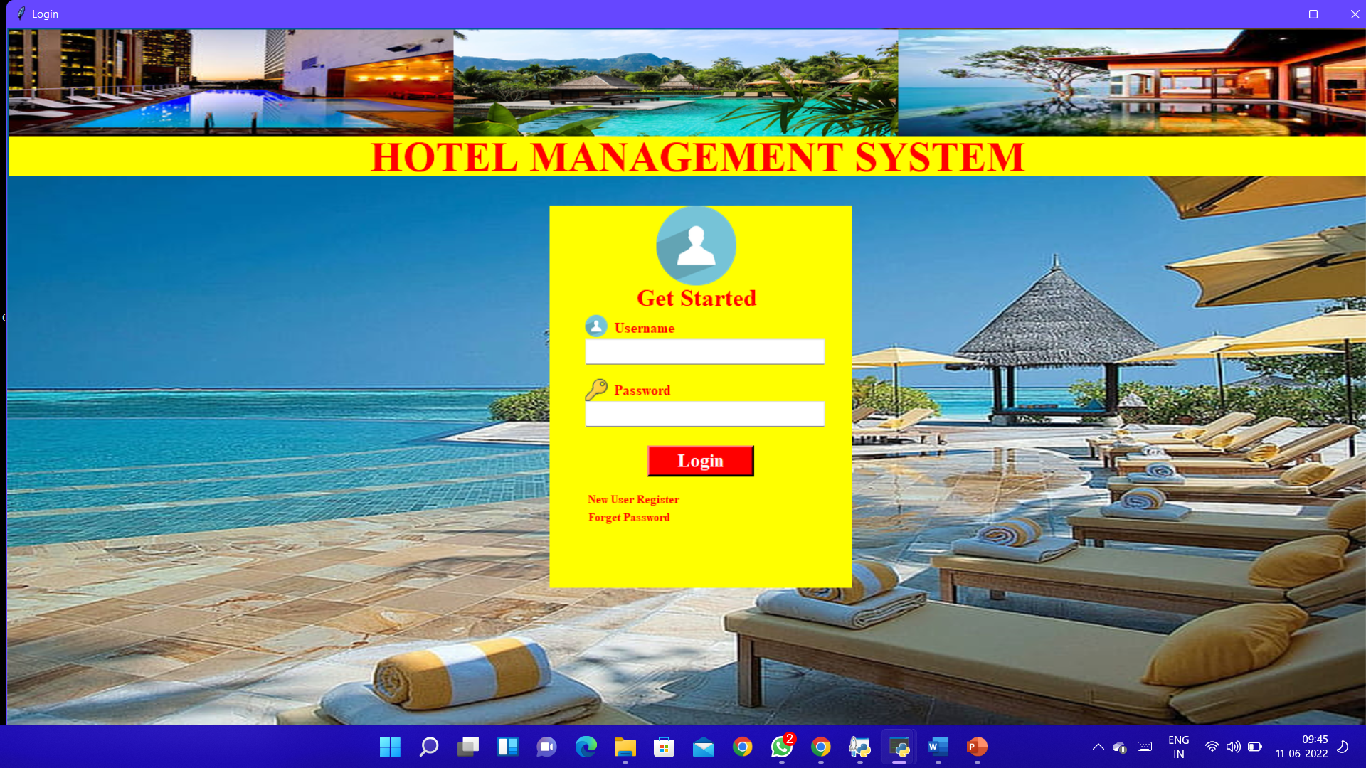
LOGIN PAGE:-

Slide 20
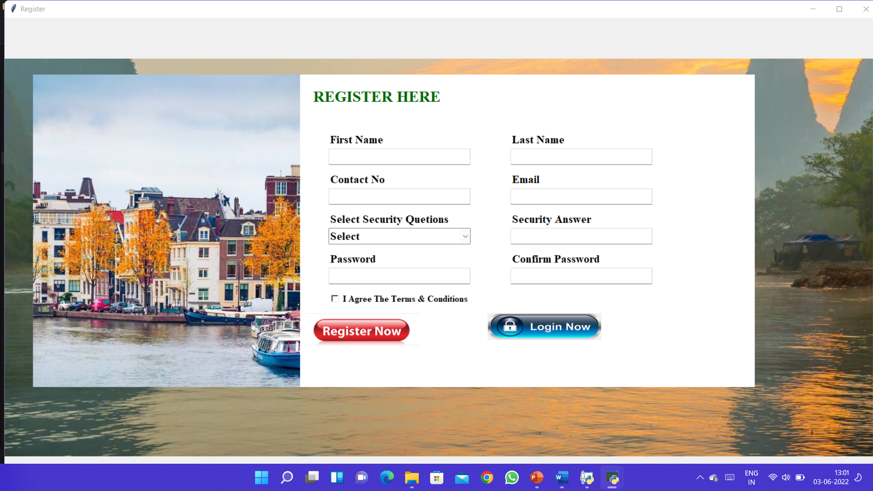
Registration page Picture:-

Slide 21
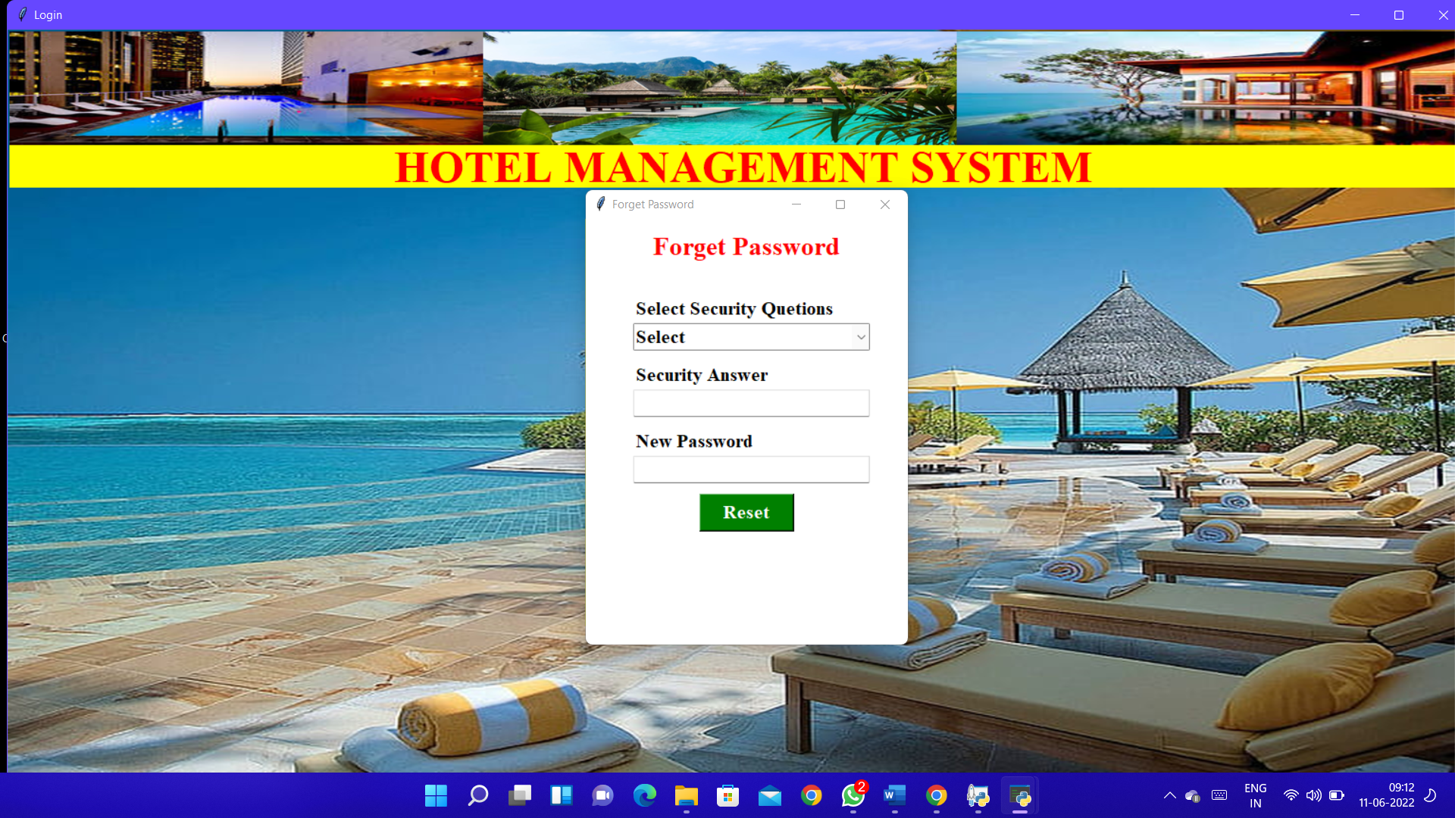
Forget password page Picture:-

Slide 22
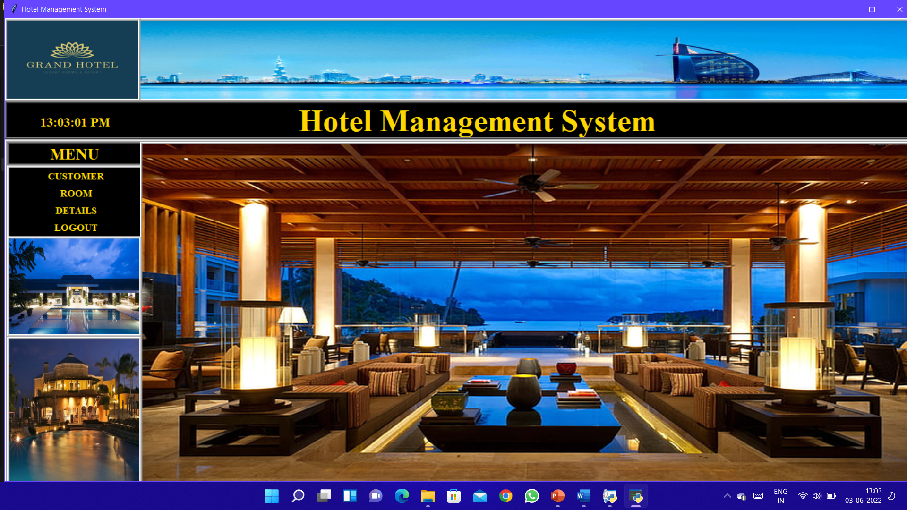
Hotel management system Picture:-

Slide 23
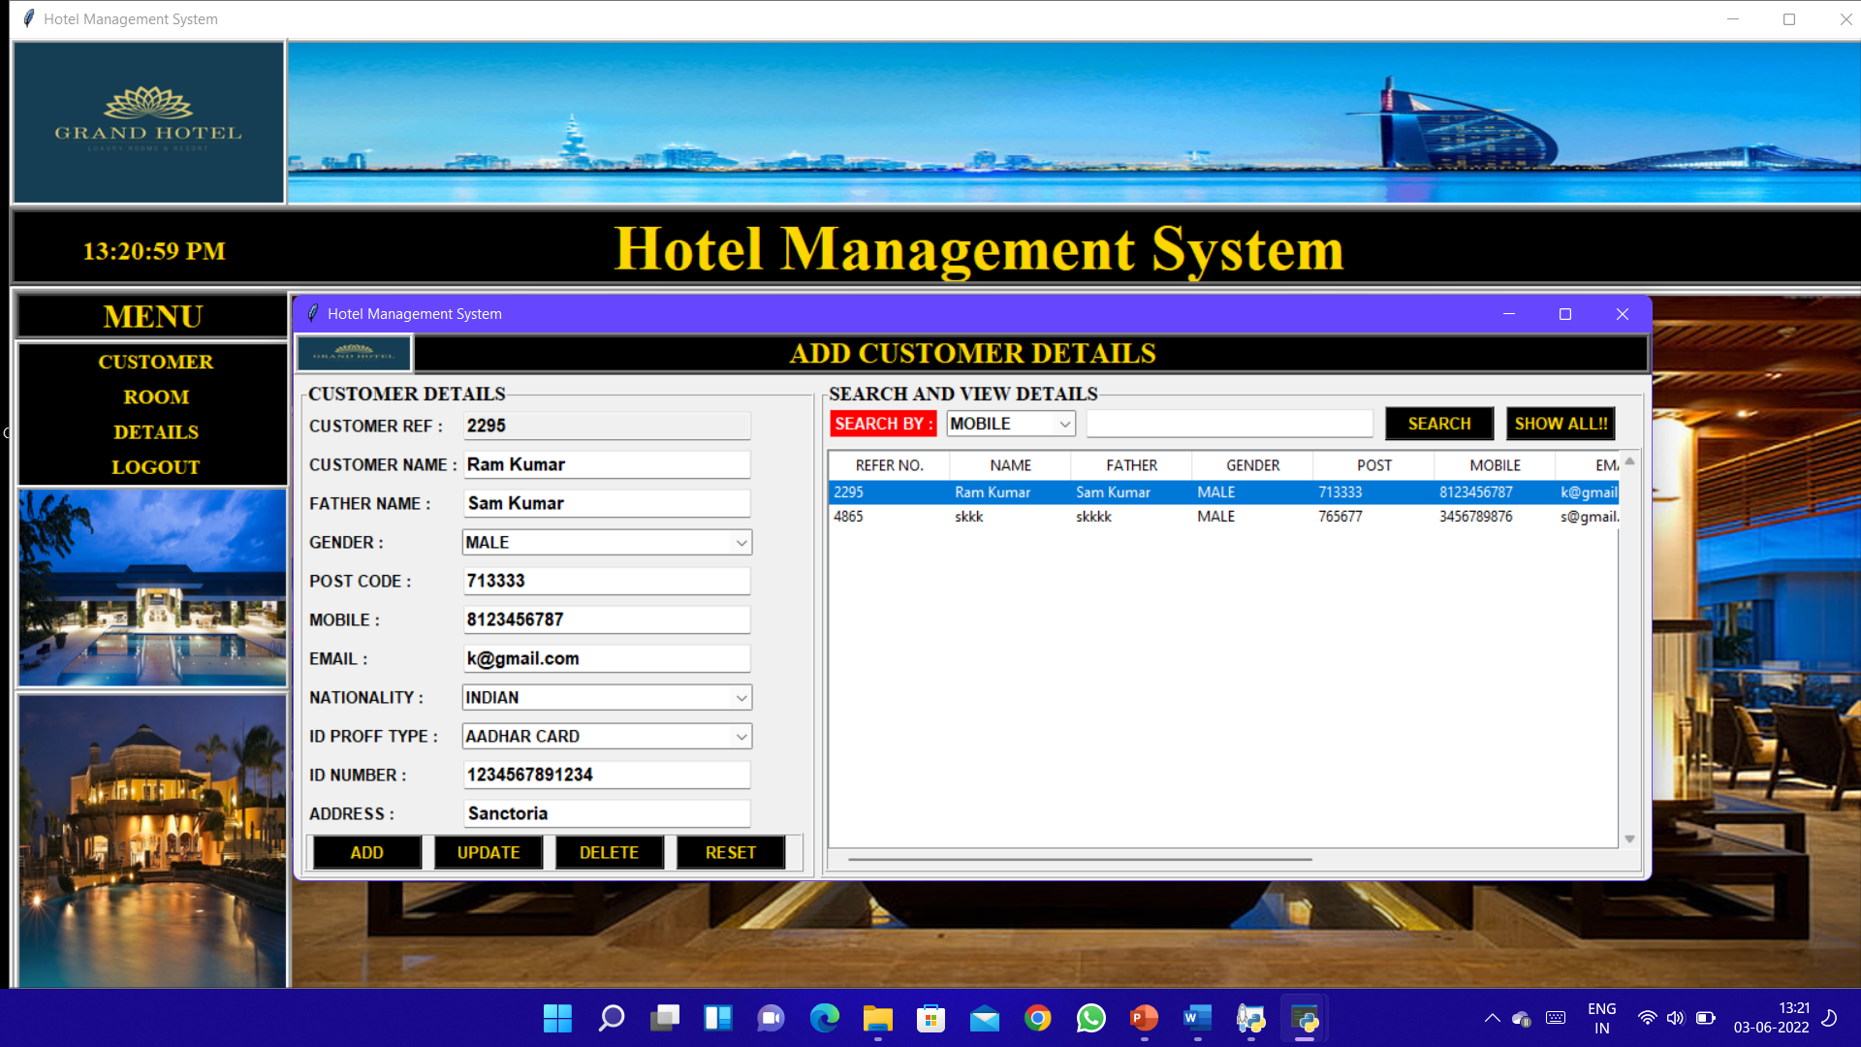
Customer details page Picture:-

Slide 24
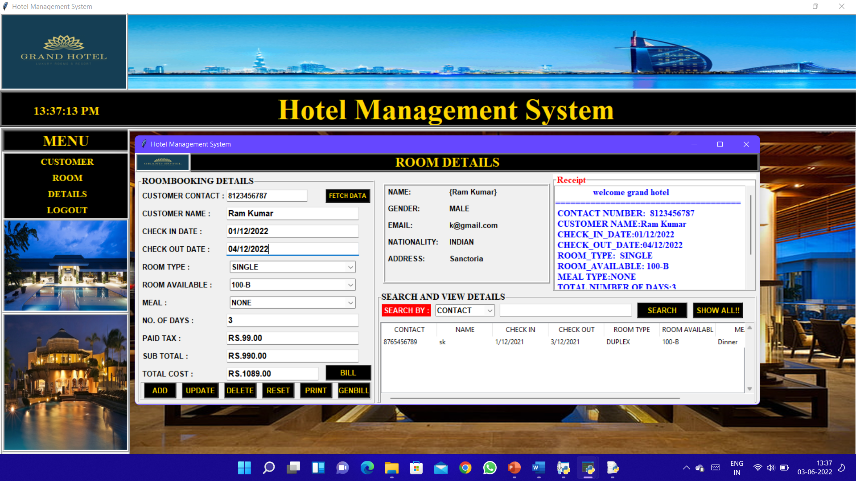
Room details page picture:-

Slide 25
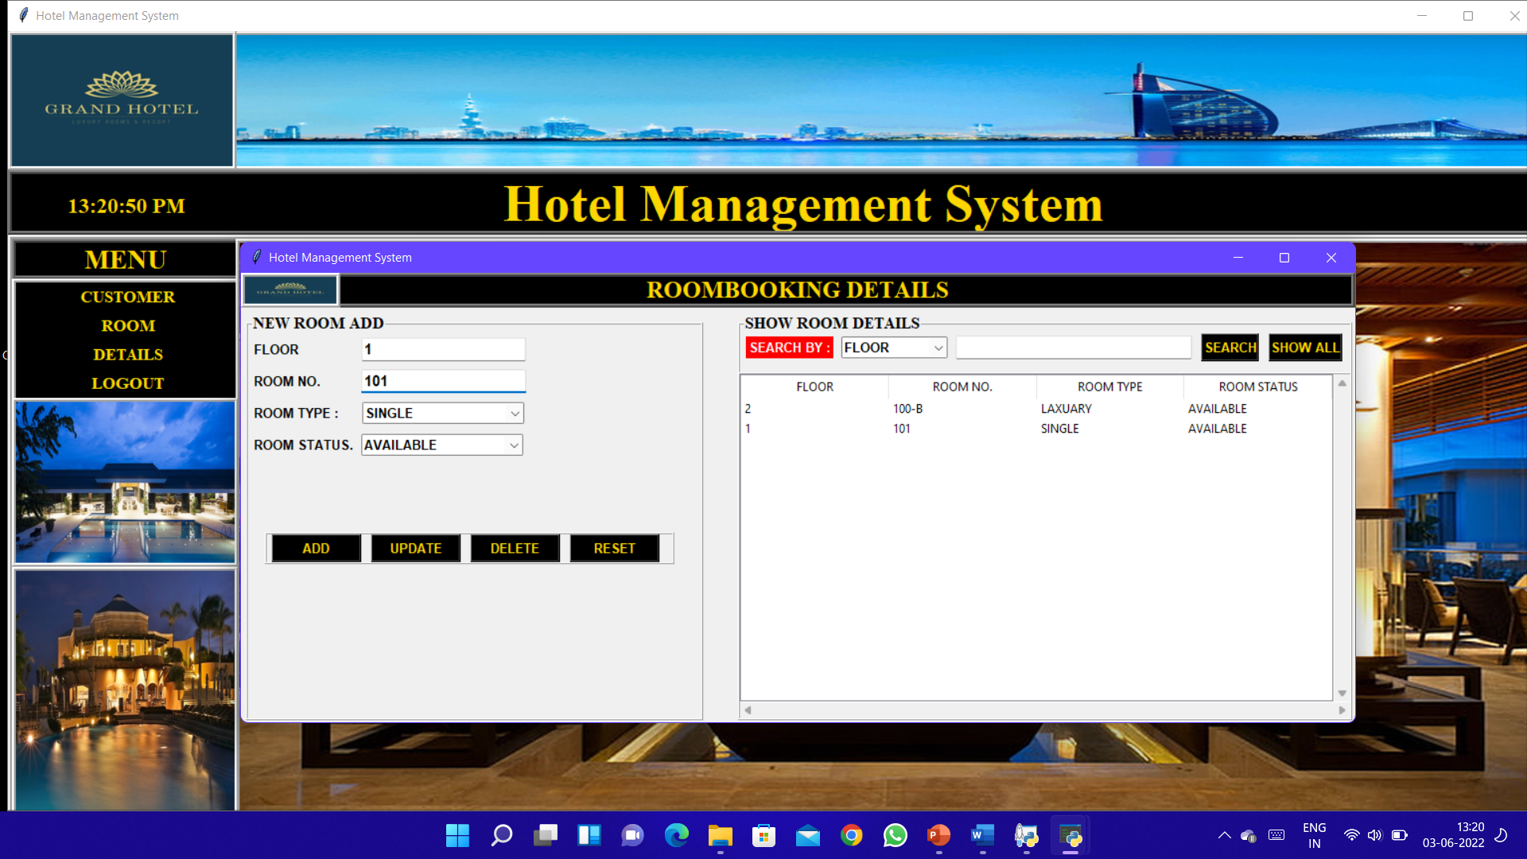
Room booking details picture

Slide 26
Advantages of existing system
I. Save time on admin tasks
ii. Develop strong relationships with your guests
iii. Implement an effective revenue management system
iv. Manage distribution functions
v. Increase bookings
vi. Accurate daily reports
vii. Prevent double bookings and manual errors
viii. Analyze your customer base

Slide 27
Disadvantages OF EXISTING SYSTEM
1. Customers can’t able to book the hotel in online mode through this system.
2. Admin can’t able to book a room for a guest through mobile because this system only support windows 10 or higher versions

Slide 28
Future scope
1. Making an online hotel booking website.
2. Making an android app for the system where the customer can book hotel by himself.
3. Enable online payment system in our site/app so the customer can pay the bill via online mode.

Slide 29
Bibliography
WEBSITE:- https://www.geeksforgeeks.org/
WEBSITE:- https://www.w3schools.com/python/
WEBSITE:- https://stackoverflow.com/
YOUTUBE:- https://www.youtube.com/channel/UCP1HhCg0ZwOyLFssftBCDIA
BOOKS:- Python: The Complete Reference

Slide 30
THANK YOU

